Slide 1

Phishing Awareness Training
Protect Yourself from Online Threats
Presented By Sachin Burman

Slide 2



Understanding Phishing Attacks
What is Phishing?
Phishing is a type of cyberattack where attackers trick individuals into revealing sensitive information.
Common Goals
steal credentials, financial data, or infect systems with malware.
Usually carried out via email, fake websites, or messages.

Slide 3
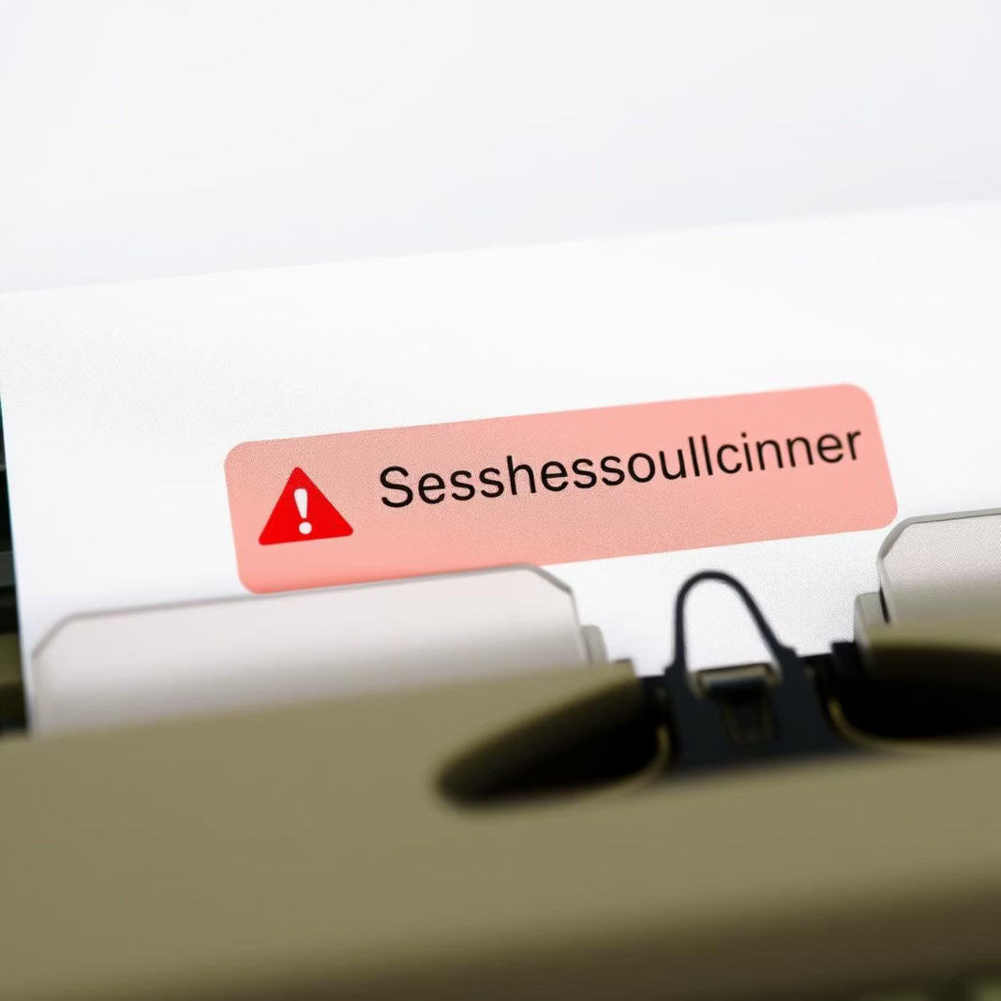
Recognising Phishing Emails
Suspicious Sender
Check the sender's email address for inconsistencies or unusual domains.
Suspicious sender address (e.g., info@amazan.net)
Urgent or threatening language (e.g., "Your account will be closed!")
Unexpected attachments or links
Grammar and spelling mistakes
Requests for personal or financial information

Slide 4
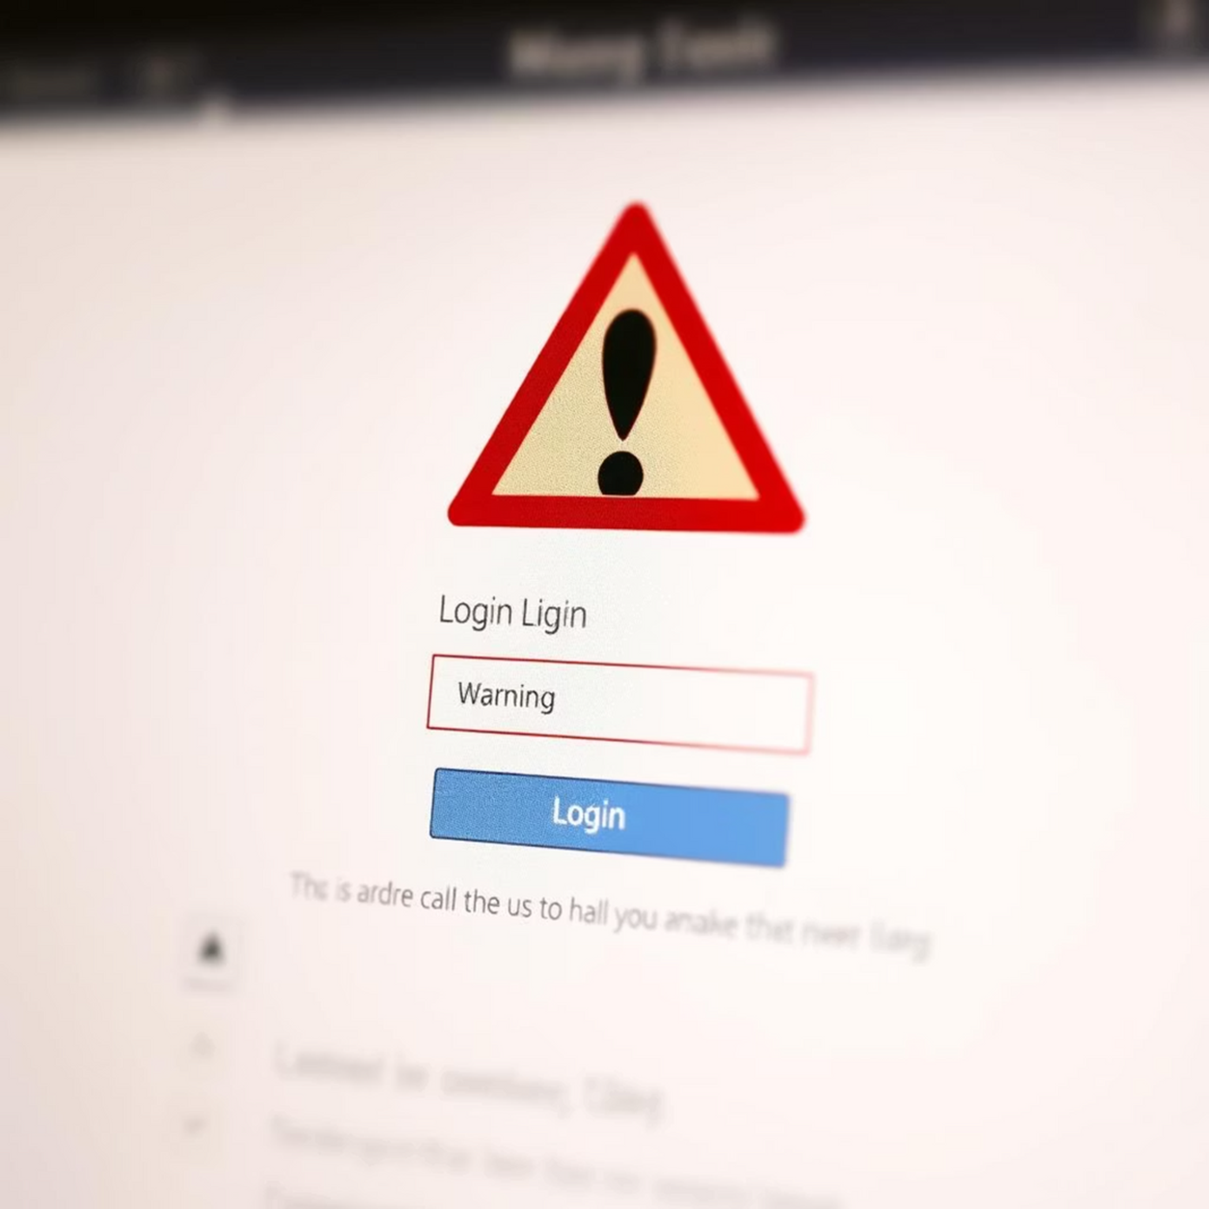
Fake Websites
Clues to Look For:
Insecure website (URL doesn't start with https://)
Fake domain names (e.g., www.bank-login-secure.com)
Pop-ups asking for sensitive info
Unusual layouts or low-quality graphics
Tip: Manually type URLs instead of clicking on

Slide 5




Spotting Red Flags
Urgent Language
Beware of messages demanding immediate action or threatening consequences.
Unusual Requests
Be cautious of unexpected offers, prizes, or requests for personal information.
Grammar & Spelling
Poor grammar and spelling are common indicators of a phishing attempt.

Slide 6

Understanding Social Engineering
What is Social Engineering?
Baiting
Luring victims with tempting offers, like free downloads, to install malware.
Manipulation techniques to trick people into giving up confidential info.
Tailgating
Physically following someone into a restricted area.

Slide 7

Best Practices for Protection
1
Verify Sender
Always double-check the sender's identity before responding.
2
Hover Over Links
Preview URLs by hovering your mouse over them before clicking.
3
Use Strong Passwords
Implement complex, unique passwords and enable multi-factor authentication.
4
Report Suspicious Emails
Forward any suspicious emails to your IT department immediately.

Slide 8
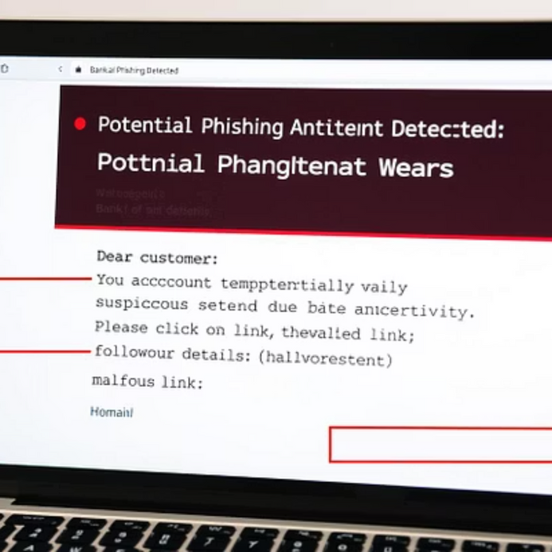
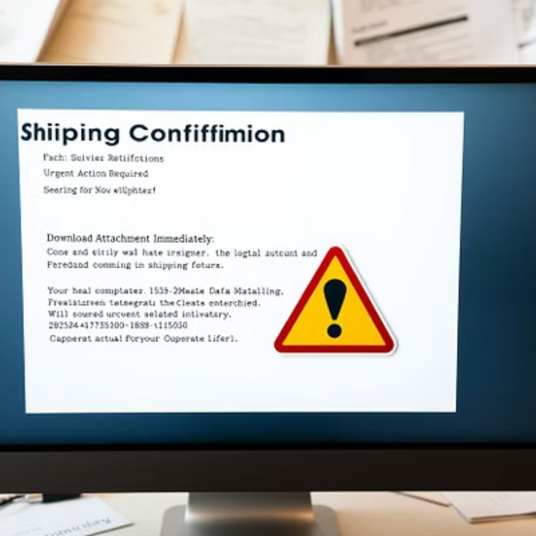
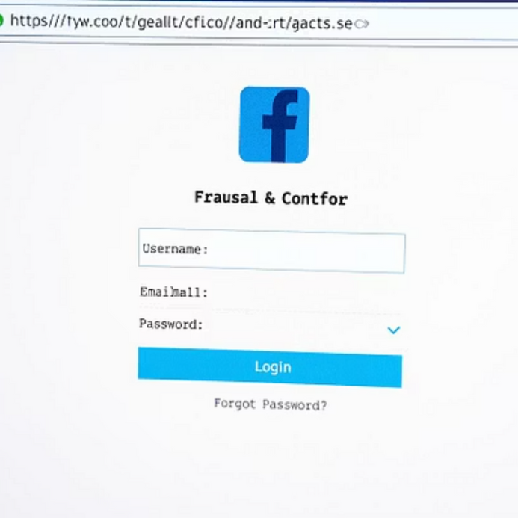
Real-World Examples
Target data breach via phishing
Attackers used a phishing email to infiltrate a vendor’s network
Resulted in millions of customer credit card numbers stolen
Google Docs phishing scam
Fake email pretending to share a document
Users who clicked allowed access to attacker-controlled apps

Slide 9

Interactive Quizzes
Question 1: Which of the following is a sign of phishing? A) Personalized greeting B) Proper grammar C) Urgent request for password reset D) Secure https link
Answer: C
Question 2: What should you do if you suspect an email is a phishing attempt? A) Click the link to verify B) Forward it to IT/security team C) Reply asking for clarification D) Delete it immediately
Answer: B

Slide 10




Key Takeaways & Next Steps
Conclusion & Resources
Educate Yourself
Report & Protect
Continuously update your knowledge on the latest phishing techniques.
Report all suspicious activity and utilise available security tools.
Stay alert and cautious online

Slide 11
Thank You

